Slide 1
Three types of Parenting Styles
Love and Logic Essentials – 9 Essential Skills
Skills 1-6
Skills 7-9
Tools of the Trade
Love and Logic starts with a hug
The Rules of Love and Logic
Two Ways to Neutralize Childhood Arguments
The Instant Empathetic Response
One-liners
One-Liners in Use
Click on the speaker icon below for the introduction to Love and Logic

Slide 2
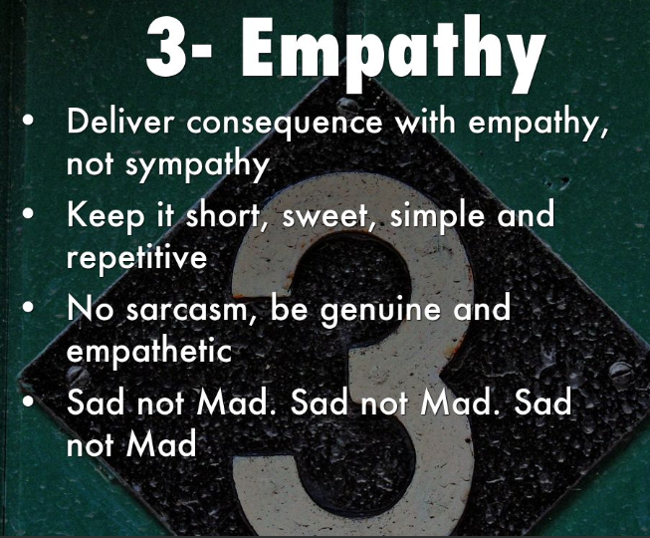
Return to Home

Slide 3
Return to Home

Slide 4
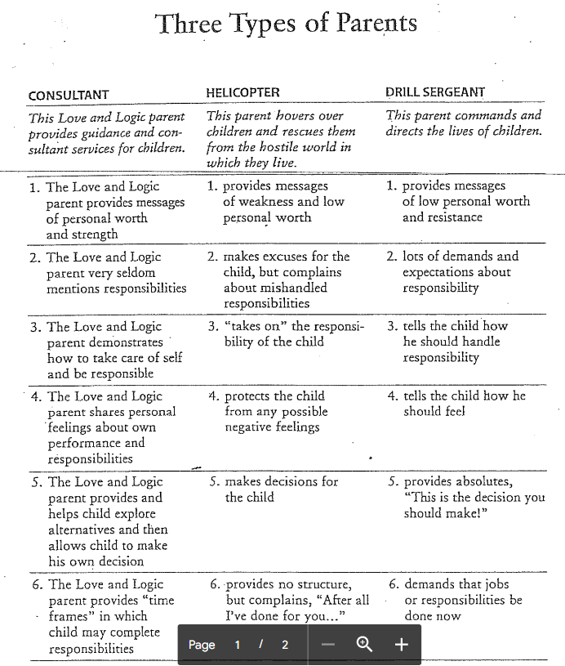
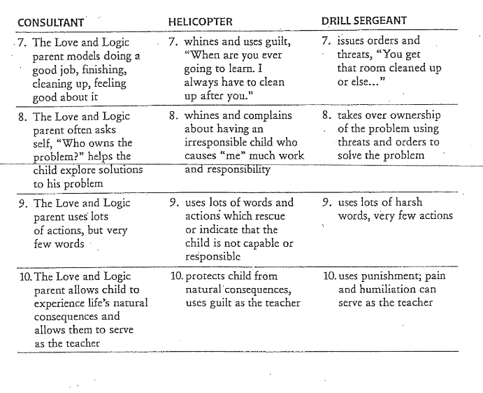
Return to Home

Slide 5
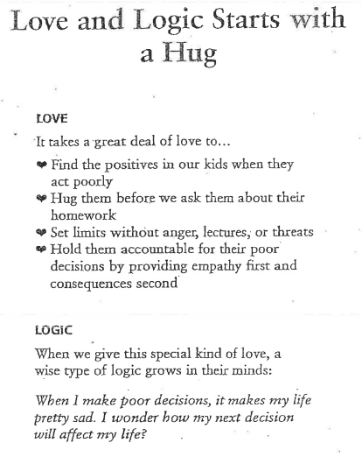
Return to Home

Slide 6
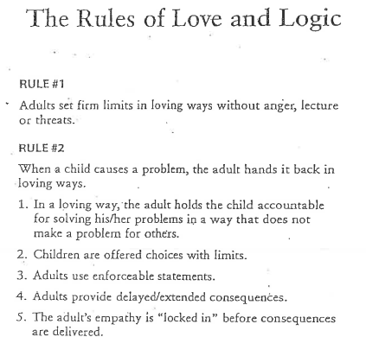
Return to Home

Slide 7
Return to Home

Slide 8
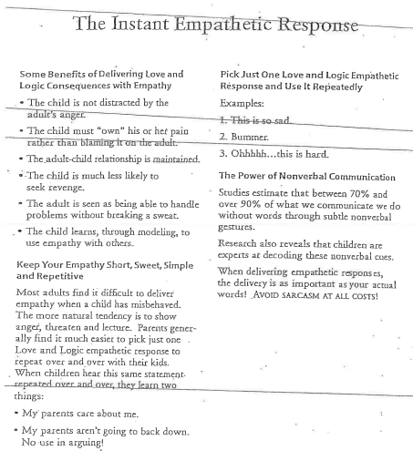
Return to Home

Slide 9
Return to Home

Slide 10
Return to Home

